Slide 1
Support Vector Machines
Lecture 07

Slide 2
Classification Techniques
Decision Tree based Methods
Rule-based Methods
Memory based reasoning
Neural Networks
Naïve Bayes and Bayesian Belief Networks
Support Vector Machines

Slide 3
Support Vector Machines
Theoretically well motivated algorithm: developed from Statistical Learning Theory (Vapnik & Chervonenkis) since the 60s
Empirically good performance: successful applications in many ﬁelds (bioinformatics, text, image recognition, . . . )

Slide 4
Support Vector Machines
Centralized website: www.kernel-machines.org.
Several textbooks, e.g. ”An introduction to Support Vector Machines” by Cristianini and Shawe-Taylor is one.
A large and diverse community work on them: from machine learning, optimization, statistics, neural networks, functional analysis, etc

Slide 5
Support Vector Machine
The goal of a support vector machine is to find the optimal separating hyperplane which maximizes the margin of the training data
Support Vector Machine” (SVM) is a supervised machine learning algorithm which can be used for both classification or regression challenges
However, it is mostly used in classification problems

Slide 6
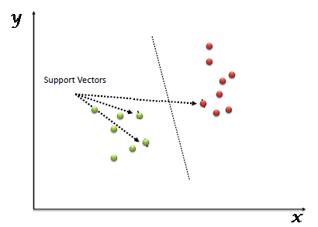

Slide 7
Support Vector Machines
Find a linear hyperplane (decision boundary) that will separate the data

Slide 8
Support Vector Machines
One Possible Solution

Slide 9
Support Vector Machines
Another possible solution

Slide 10
Support Vector Machines
Other possible solutions

Slide 11
Support Vector Machines
Which one is better? B1 or B2?
How do you define better?

Slide 12
Support Vector Machines
Find hyperplane maximizes the margin => B1 is better than B2

Slide 13
What is a Hyperplane
An hyperplane is a generalization of a plane
in one dimension, an hyperplane is called a point
in two dimensions, it is a line
in three dimensions, it is a plane
in more dimensions you can call it an hyperplane

Slide 14
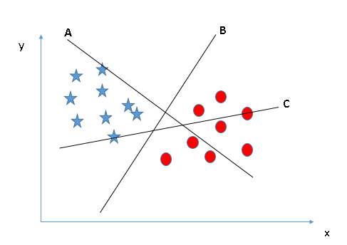
Identify the right hyper-plane (Scenario-1)
Select the hyper-plane which segregates the two classes better”. In this scenario, hyper-plane “B” has excellently performed this job

Slide 15
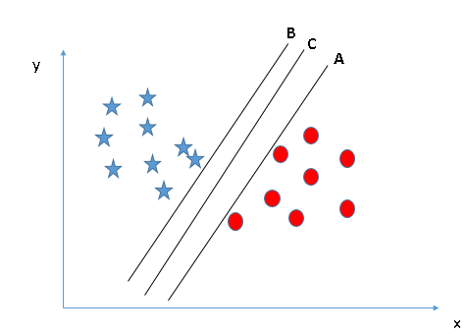
Identify the right hyper-plane (Scenario-2)
A, B and C are all good hyperplanes
Here, maximizing the distances between nearest data point (either class) and hyper-plane will help us to decide the right hyper-plane
This distance is called as Margin

Slide 16
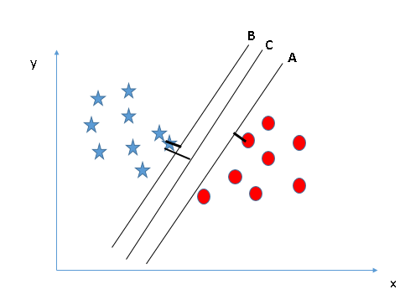
Identify the right hyper-plane (Scenario-2)
Margin for hyper-plane C is high as compared to both A and B
Hence, we name the right hyper-plane as C
Another lightning reason for selecting the hyper-plane with higher margin is robustness
If we select a hyper-plane having low margin then there is high chance of miss-classification

Slide 17
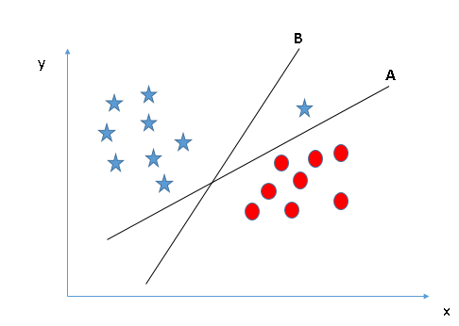
Identify the right hyper-plane (Scenario-3)
Hyper-plane B may be selected due to higher margin compared to A
But, here is the catch, SVM selects the hyper-plane which classifies the classes accurately prior to maximizing margin
Here, hyper-plane B has a classification error and A has classified all correctly. Therefore, the right hyper-plane is A

Slide 18
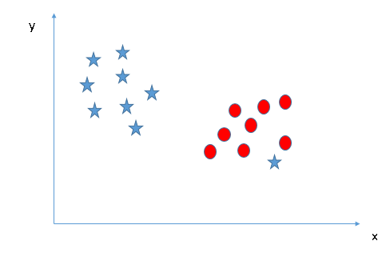
Identify the right hyper-plane (Scenario-4)
Outliers ignored by SVM

Slide 19
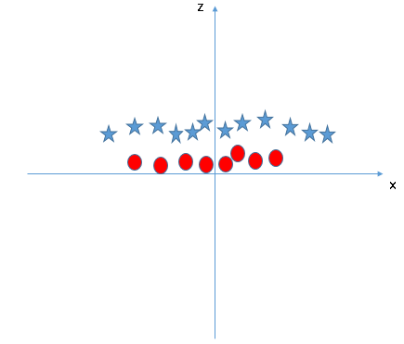
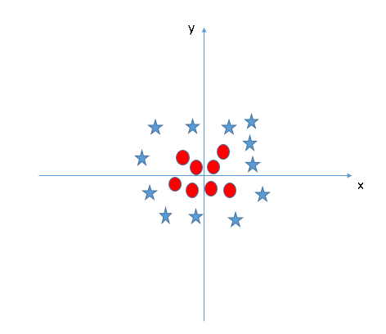
Identify the right hyper-plane (Scenario-5)
z=x^2+y^2

Slide 20
Support Vector Machines

Slide 21
Support Vector Machines
The support vectors are indicated by the circles around them
Datapoints in this subset are called “support vectors”
It will be useful computationally if only a small fraction of the data points are support vectors,
Since, we use the support vectors to decide which side of the separator a test case is on

Slide 22
Support Vector Machines
We want to maximize:
Which is equivalent to minimizing:
But subjected to the following constraints:
This is a constrained optimization problem
Numerical approaches to solve it (e.g., quadratic programming)

Slide 23
Support Vector Machines
What if the problem is not linearly separable?

Slide 24
Support Vector Machines
Introduce slack variables
Need to minimize:
Subject to:

Slide 25
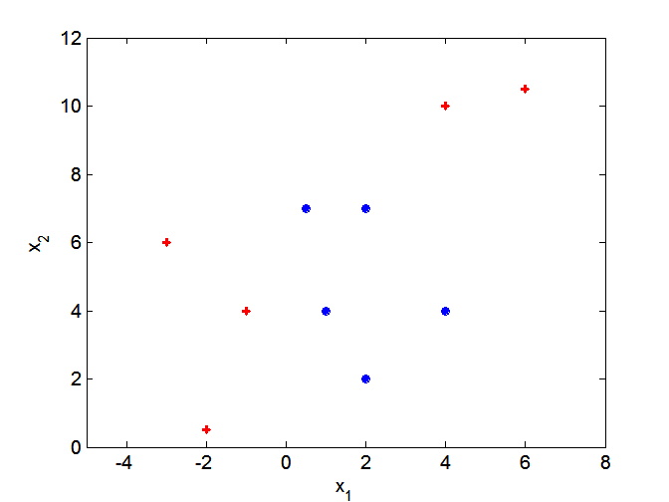
Nonlinear Support Vector Machines
What if decision boundary is not linear?

Slide 26
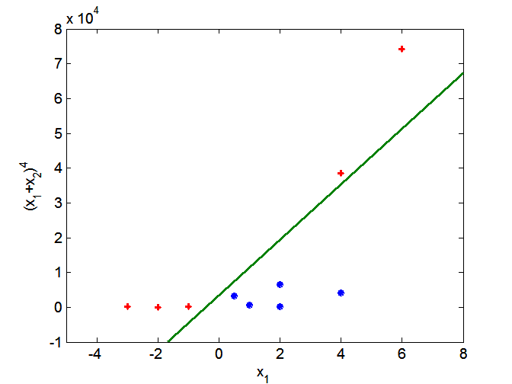
Nonlinear Support Vector Machines
Transform data into higher dimensional space

Slide 27
Nonlinear Support Vector Machines
Kernel Trick
SVM has a technique called the kernel trick
These are functions which takes low dimensional input space and transform it to a higher dimensional space
i.e. it converts not separable problem to separable problem, these functions are called kernels
It is mostly useful in non-linear separation problem
http://crsouza.com/2010/03/17/kernel-functions-for-machine-learning-applications/

Slide 28
References
Introduction to Data Mining by Tan, Steinbach, Kumar (Lecture Slides)
https://www.analyticsvidhya.com/blog/2015/10/understaing-support-vector-machine-example-code/
http://www.svm-tutorial.com/2014/11/svm-understanding-math-part-1/

Slide 29
Questions!

